Slide 1
Monte Carlo Tree Search and it Applications
Presented by:
Ishaan Kangriwala (E019)
Paarth Kapasi (E020)
Dhruv Patel (E035)
Mentor:
Prof. Jyoti Shete

Slide 2
INTRODUCTION
Monte Carlo Tree Search (MCTS) is a search technique in the field of Artificial Intelligence (AI). It is a probabilistic and heuristic driven search algorithm that combines the classic tree search implementations alongside machine learning principles of reinforcement learning.
In tree search, there’s always the possibility that the current best action is actually not the most optimal action. In such cases, MCTS algorithm becomes useful as it continues to evaluate other alternatives periodically during the learning phase by executing them, instead of the current perceived optimal strategy.
This is known as the “exploration-exploitation trade-off ”.

Slide 3

What is exploration-exploitation trade-off
Exploration helps in exploring and discovering the unexplored parts of the tree, which could result in finding a more optimal path. Exploration can be useful to ensure that MCTS is not overlooking any potentially better paths.
But it quickly becomes inefficient in situations with large number of steps or repetitions. In order to avoid that, it is balanced out by exploitation. Exploitation sticks to a single path that has the greatest estimated value.
The algorithm applied to trees helps to balance the exploration-exploitation trade-off by periodically exploring relatively unexplored nodes of the tree and discovering potentially more optimal paths than the one it is currently exploiting.
Notes:
It exploits the actions and strategies that is found to be the best till now but also must continue to explore the local space of alternative decisions and find out if they could replace the current best.
In other words, we can say that exploration expands the tree’s breadth more than its depth.
This is a greedy approach and this will extend the tree’s depth more than its breadth.
For this characteristic, MCTS becomes particularly useful in making optimal decisions in Artificial Intelligence (AI) problems.

Slide 4
PROBLEM DEFINITION
This project aims to study the working of Monte Carlo Tree Search and its applications in general video games.

Slide 5
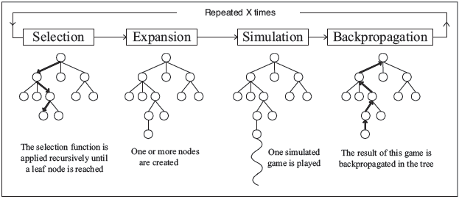
Working of MCTS
In MCTS, nodes are the building blocks of the search tree. These nodes are formed based on the outcome of a number of simulations. The process of Monte Carlo Tree Search can be broken down into four distinct steps,
Selection
Expansion
Simulation
Backpropagation
Notes:
Each of these steps is explained in the following slides

Slide 6
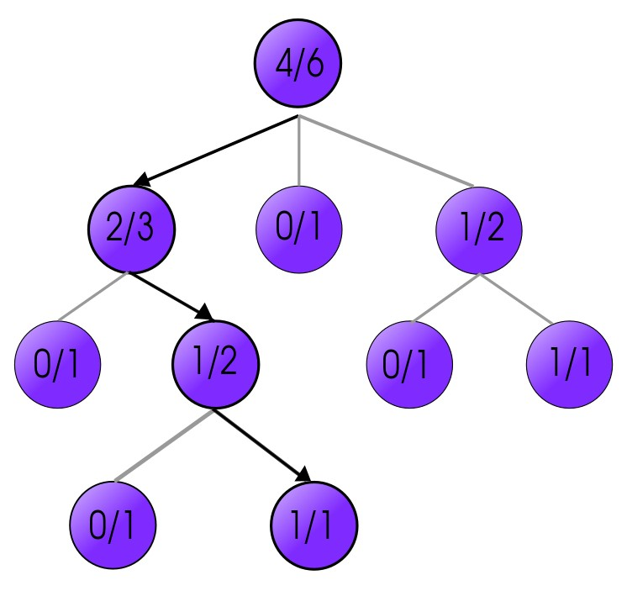
Selection
In this process, the MCTS algorithm traverses the current tree from the root node using a specific strategy. The strategy uses an evaluation function to optimally select nodes with the highest estimated value. MCTS uses the Upper Confidence Bound (UCB) formula applied to trees as the strategy in the selection process to traverse the tree. It balances the exploration-exploitation trade-off. During tree traversal, a node is selected based on some parameters that return the maximum value. The parameters are characterized by the formula that is typically used for this purpose is given below.
When traversing a tree during the selection process, the child node that returns the greatest value from the above equation will be one that will get selected. During traversal, once a child node is found which is also a leaf node, the MCTS jumps into the expansion step.

Slide 7
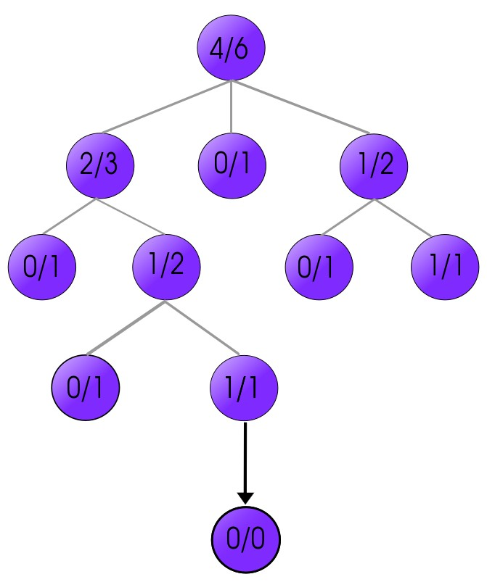
Expansion
After selection stops, there will be at least one unvisited move in the search tree (hereafter referred to as unexpanded moves). Now, we randomly choose one unexpanded move and we then create the child node corresponding to that move (bolded in the diagram). We add this node as a child to the last selected node in the selection phase, expanding the search tree. The statistics information in the node is initialized with 0 wins out of 0 simulations (wᵢ = 0, sᵢ = 0).
Some implementations choose to expand the tree by multiple nodes per simulation, but the most memory-efficient implementation is to create just one node per simulation. The search tree can get very large, especially for games with large branching factors.

Slide 8
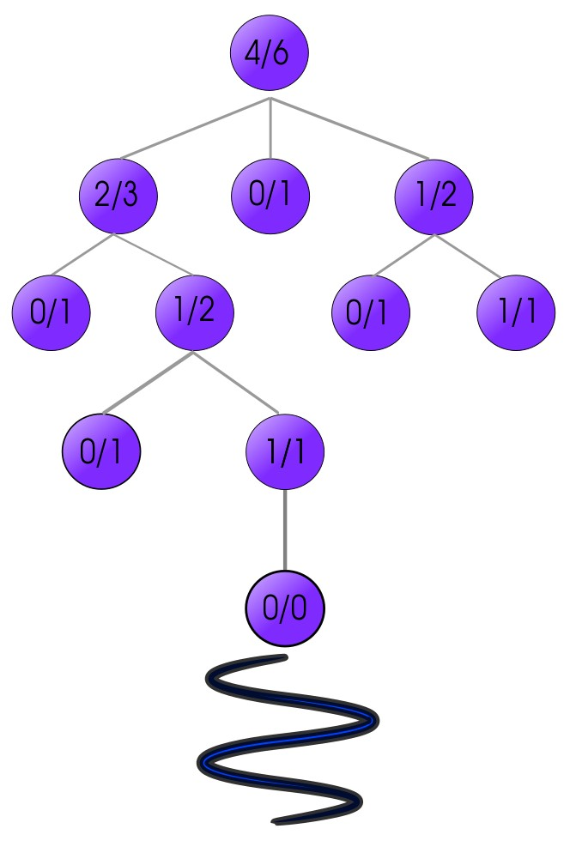
Simulation
Continuing from the newly-created node in the expansion phase, moves are selected randomly and the game state is repeatedly advanced. This repeats until the game is finished and a winner emerges. No new nodes are created in this phase.
This is a good time to remind ourselves that nodes in the search tree correspond to nodes in the game tree. In this phase, we are simply applying the rules of the game to repeatedly (1) find all legal moves in the current game state, (2) choose one legal move randomly, then (3) advance the game state. No part of this process is stored. This phase ends when we reach a state where the game is finished.
Notes:
Note: A game played during the simulation phase is either called a simulation or a playout. This may get confusing because one iteration of the whole 4-phase process is also sometimes called a simulation or a playout. Be aware of this and use your discretion to disambiguate.

Slide 9
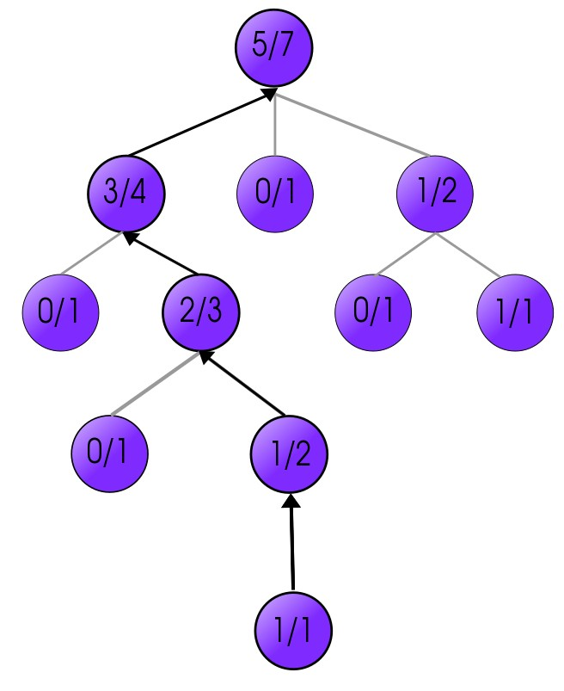
Back Propagation
After determining the value of the newly added node, the remaining tree must be updated. So, the backpropagation process is performed, where it backpropagates from the new node to the root node. During the process, the number of simulation stored in each node is incremented. Also, if the new node’s simulation results in a win, then the number of wins is also incremented.

Slide 10
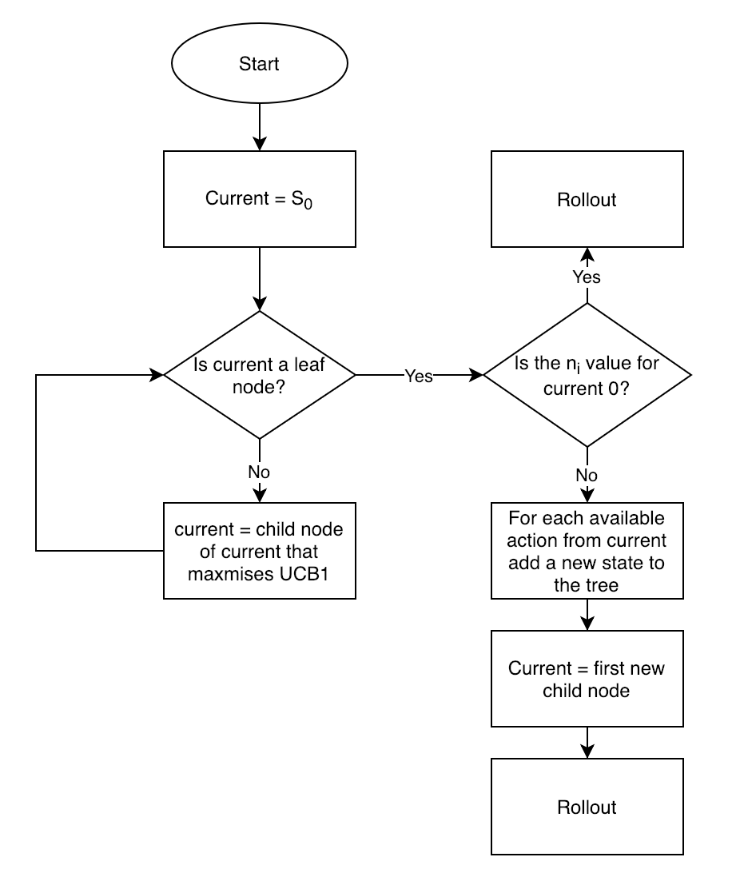
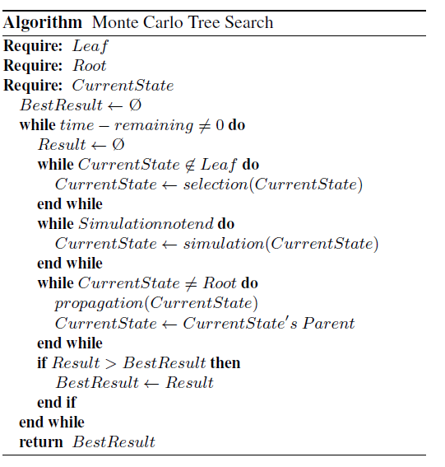
Flowchart and Algorithm

Slide 11
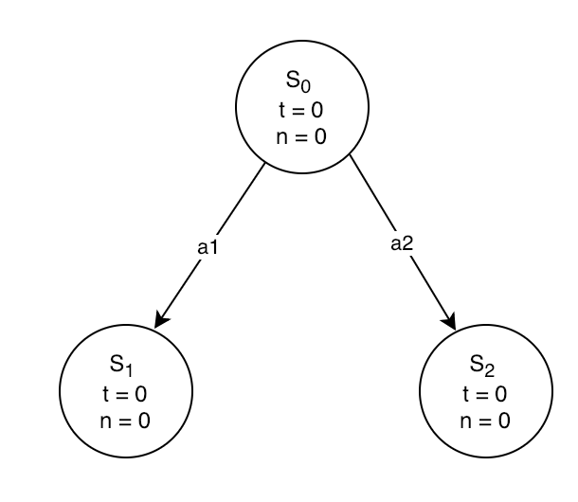
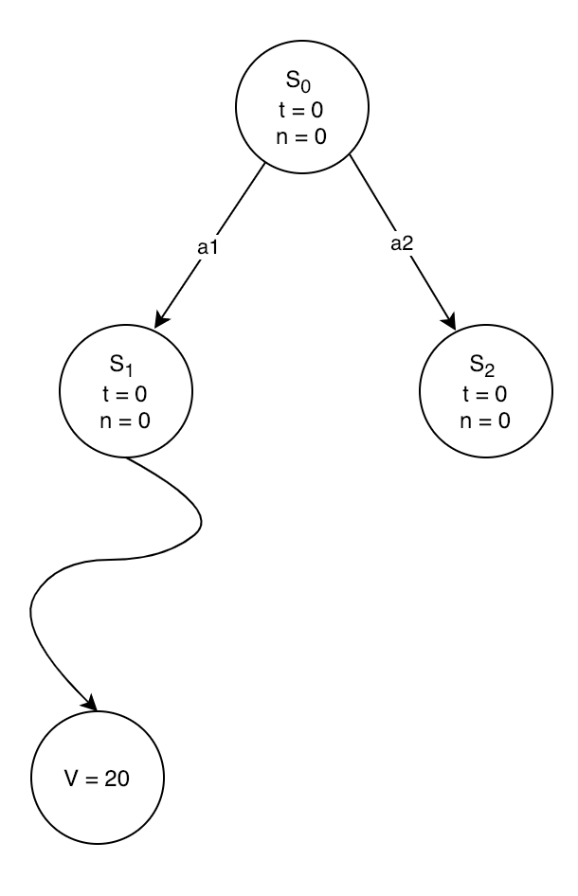
Complete Walkthrough with an Example
Iteration 1
Initial State
Rollout from S1
Back Propagation

Slide 12
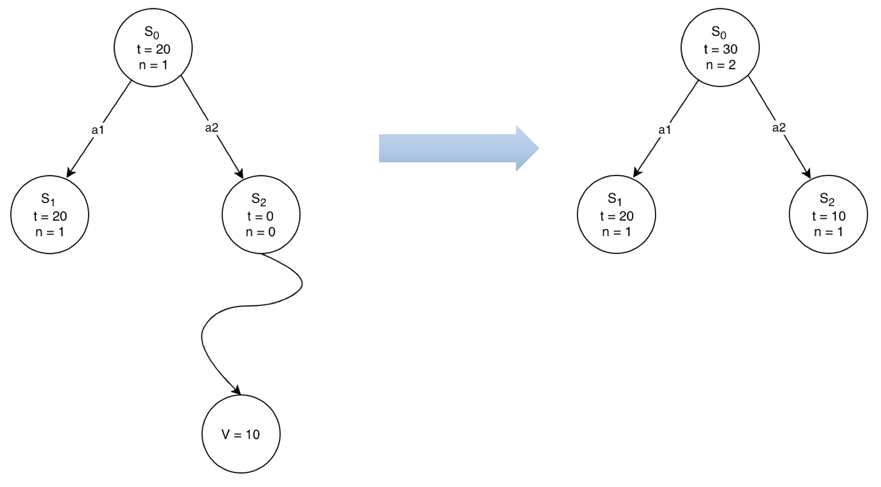
Complete Walkthrough with an Example
Iteration 2
Back Propagation from S2

Slide 13
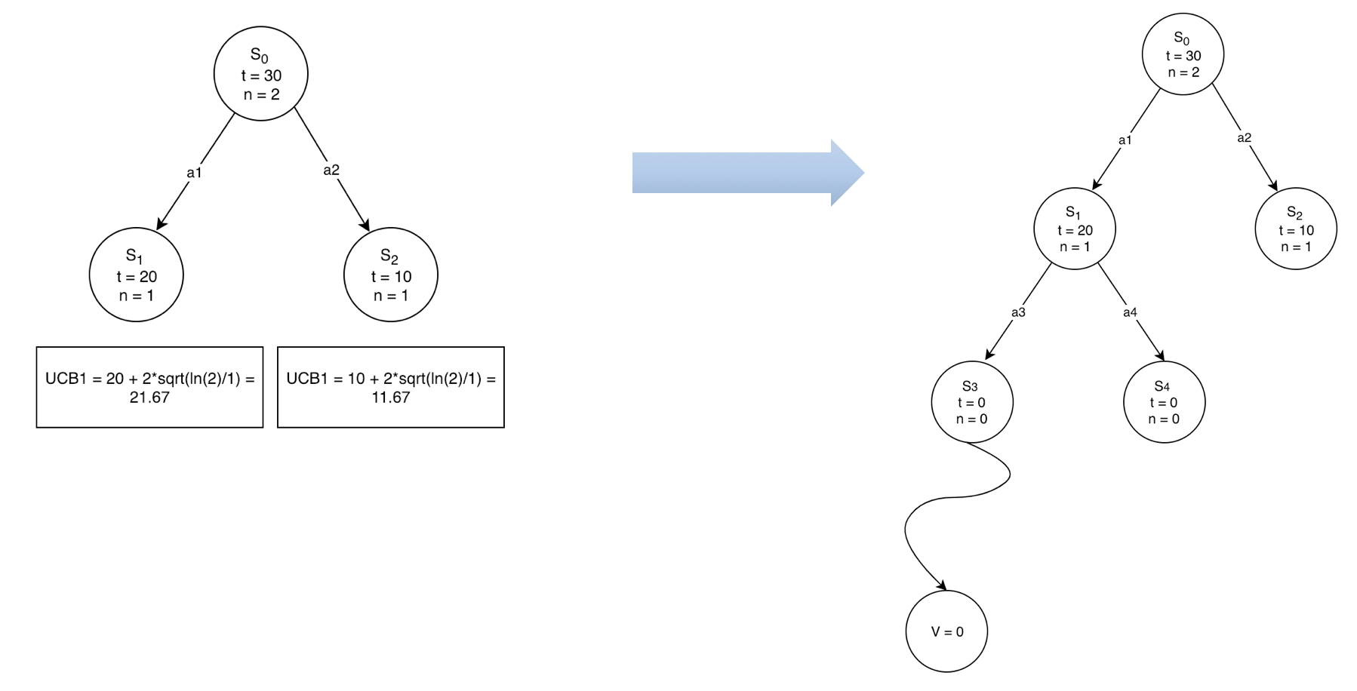
Complete Walkthrough with an Example
Iteration 3

Slide 14
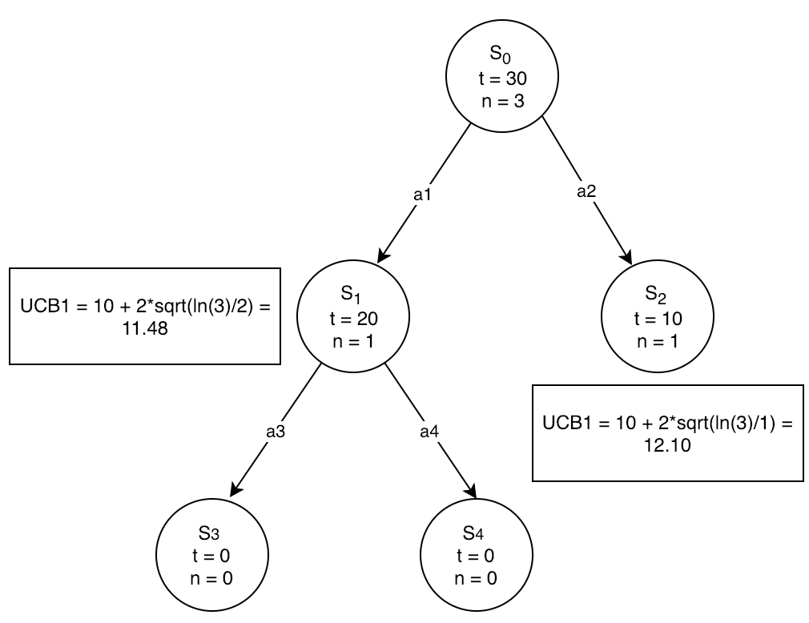
Complete Walkthrough with an Example
Iteration 4
Notes:
Now Paarth will be speaking about the applictions of mcts in games.

Slide 15
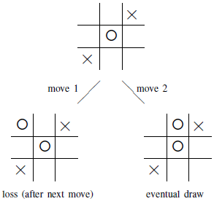
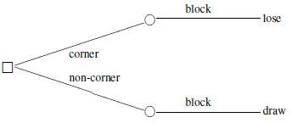
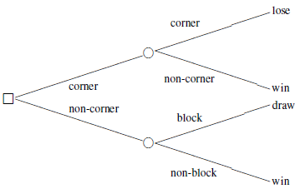
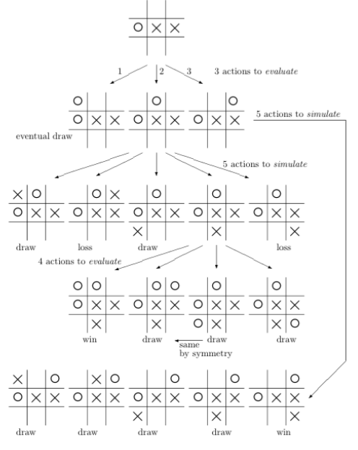
MCTS in Tic Tac Toe

Slide 16
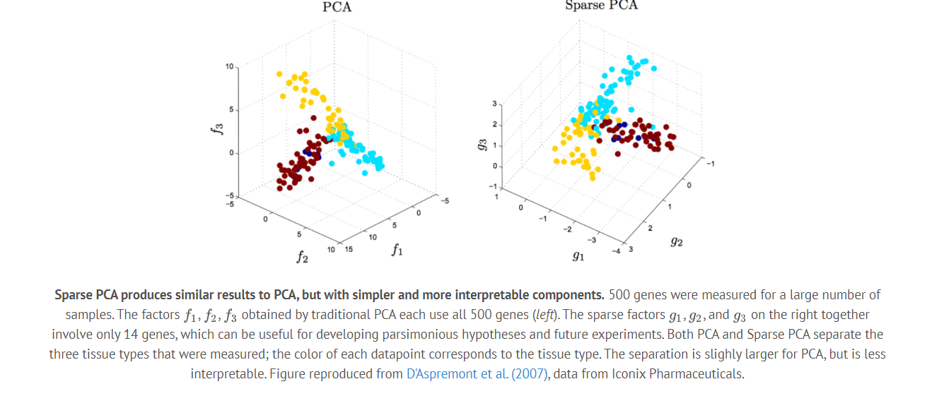
Sparse PCA
How are sparsity structures applied?

Slide 17
Sparse PCA
Applications:
Financial Data Analysis
Biological Data Analysis
Machine Learning Algorithms

Slide 18
Comparative Analysis
Of all the papers we reviewed we specifically selected a paper which performed a comparative analysis of the performance of these extensions of PCA. In the paper PCA, SPCA and KPCA are applied to the Cleveland heart failure dataset and outputs are studied.
Dataset Description:
The Cleveland HF database has data of 303 subjects and 76 raw features.
Out of the 76 raw features only commonly used 13 HF features are utilized in this study whose details are as follows:
Age, Sex, Chest Pain Type, Resting Blood Pressure, Serum Cholesterol, Fasting Blood Sugar, Resting Electrocardiographic Results, Maximum Heart Rate achieved, Exercise Induced Angina, Old Peak, Peak Exercise Slope, Number of Major Vessels Colored by Fluoroscopy (VCA) and Thallium Scan.
After applying the various PCA methods for feature extraction the model is integrated with LDA model and their performance is observed.

Slide 19
Advantages
MCTS is a simple algorithm to implement.
Monte Carlo Tree Search is a heuristic algorithm. MCTS can operate effectively without any knowledge in the particular domain, apart from the rules and end conditions, and can can find its own moves and learn from them by playing random playouts.
The MCTS can be saved in any intermediate state and that state can be used in future use cases whenever required.
MCTS supports asymmetric expansion of the search tree based on the circumstances in which it is operating.

Slide 20
Disadvantages
As the tree growth becomes rapid after a few iterations, it requires a huge amount of memory.
There is a bit of a reliability issue with Monte Carlo Tree Search. In certain scenarios, there might be a single branch or path, that might lead to loss against the opposition when implemented for those turn-based games. This is mainly due to the vast amount of combinations and each of the nodes might not be visited enough number of times to understand its result or outcome in the long run.
MCTS algorithm needs a huge number of iterations to be able to effectively decide the most efficient path. So, there is a bit of a speed issue there.

Slide 21
CONCLUSION
All methods of PCA are useful and which method to choose depends on the conditions of the dataset to be worked upon.
If the data has linear correlations and is not too big in size ,standard PCA can be used.
If the data is non-linear and medium in size KPCA is a useful technique.
A particular disadvantage of ordinary PCA is that the principal components are usually linear combinations of all input variables. Sparse PCA overcomes this disadvantage by finding linear combinations that contain just a few input variables.

Slide 22
Future work
Improvements
Dozens of MCTS enhancements have been suggested to date. These can generally be described as being either domain knowledge or domain independent.
Domain Knowledge Domain knowledge specific to the current game can be exploited in the tree to filter out implausible moves or in the simulations to produce heavy playouts that are more similar to playouts that would occur between human opponents. This means that playout results will be more realistic than random simulations and that nodes will require fewer iterations to yield realistic reward values.
Domain knowledge can yield significant improvements, at the expense of speed and loss of generality.
Domain Independent Domain independent enhancements apply to all problem domains. These are typically applied in the tree (e.g. AMAF) although again some apply to the simulations (e.g. prefer winning moves during playouts). Domain independent enhancements do not tie the implementation to a particular domain, maintaining generality, and are hence the focus of most current work in the area.

Slide 23
REFERENCES
C. B. Browne et al., "A Survey of Monte Carlo Tree Search Methods," in IEEE Transactions on Computational Intelligence and AI in Games, vol. 4, no. 1, pp. 1-43, March 2012, doi: 10.1109/TCIAIG.2012.2186810.Zou, Hui & Hastie, Trevor & Tibshirani, Robert. (2004). Sparse Principal Component Analysis. Policy. 1-30. 10.1198/106186006X113430.
M. C. Fu, "MONTE CARLO TREE SEARCH: A TUTORIAL," 2018 Winter Simulation Conference (WSC), Gothenburg, Sweden, 2018, pp. 222-236, doi: 10.1109/WSC.2018.8632344.
Magnuson, Max (2015) "Monte Carlo Tree Search and Its Applications," Scholarly Horizons: University of Minnesota, Morris Undergraduate Journal: Vol. 2 : Iss. 2 , Article 4.
T. Toyoda and Y. Kotani, "Monte Carlo Go Using Previous Simulation Results," 2010 International Conference on Technologies and Applications of Artificial Intelligence, Hsinchu, Taiwan, 2010, pp. 182-186, doi: 10.1109/TAAI.2010.39.
G. Zuo and C. Wu, "A heuristic Monte Carlo tree search method for surakarta chess," 2016 Chinese Control and Decision Conference (CCDC), Yinchuan, China, 2016, pp. 5515-5518, doi: 10.1109/CCDC.2016.7531982.
C. F. Sironi and M. H. M. Winands, "Analysis of Self-Adaptive Monte Carlo Tree Search in General Video Game Playing," 2018 IEEE Conference on Computational Intelligence and Games (CIG), Maastricht, Netherlands, 2018, pp. 1-4, doi: 10.1109/CIG.2018.8490402.
Chaslot, Guillaume & Bakkes, Sander & Szita, Istvan & Spronck, Pieter. (2008). Monte-Carlo Tree Search: A New Framework for Game AI.. Bijdragen.
D. A. Chentsov and S. A. Belyaev, "Monte Carlo Tree Search Modification for Computer Games," 2020 IEEE Conference of Russian Young Researchers in Electrical and Electronic Engineering (EIConRus), St. Petersburg and Moscow, Russia, 2020, pp. 252-255, doi: 10.1109/EIConRus49466.2020.9039281.
M. C. Fu, "AlphaGo and Monte Carlo tree search: The simulation optimization perspective," 2016 Winter Simulation Conference (WSC), Washington, DC, USA, 2016, pp. 659-670, doi: 10.1109/WSC.2016.7822130.

Slide 24
THANK YOU!

